Slide 1
The MH6502
The hardware comes forth!

Slide 2
Context
Started as a lockdown project
Inspired by Ben Eater videos
Had to relearn electronics
Had to purchase tools and components
Try, try and try…

Slide 3
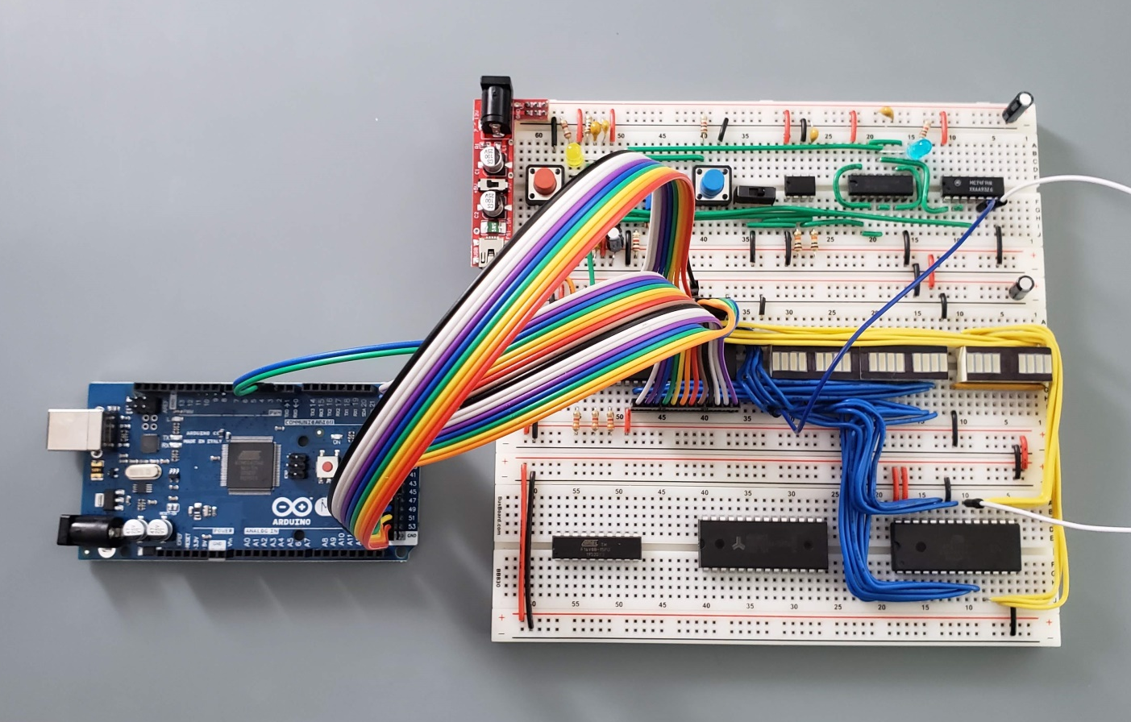
Breadboard history

Slide 4
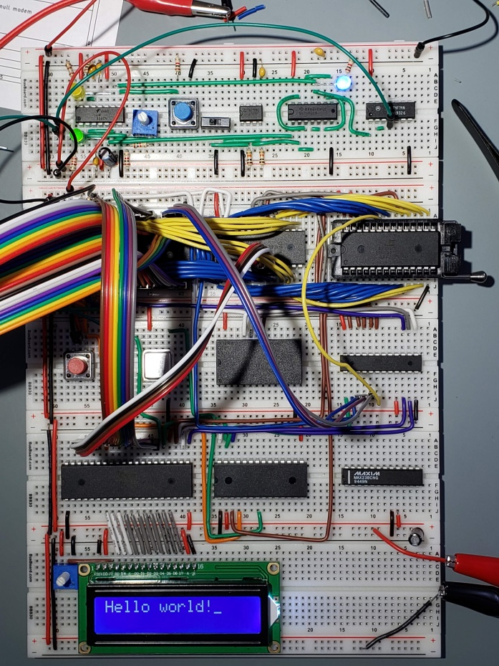
Breadboard history

Slide 5
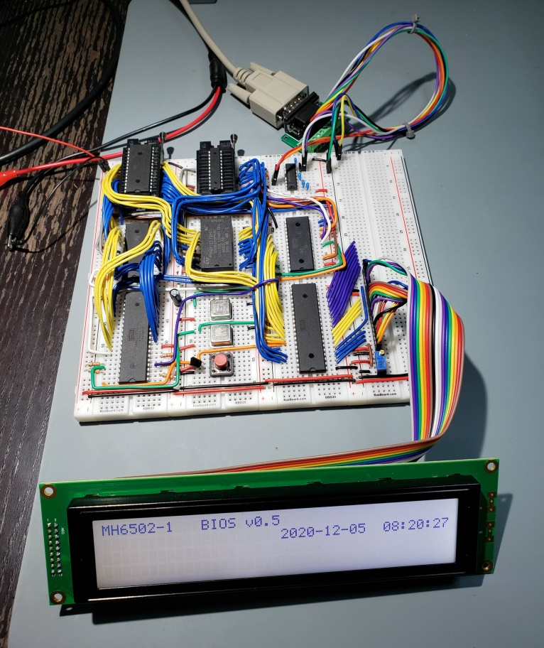
Breadboard history

Slide 6
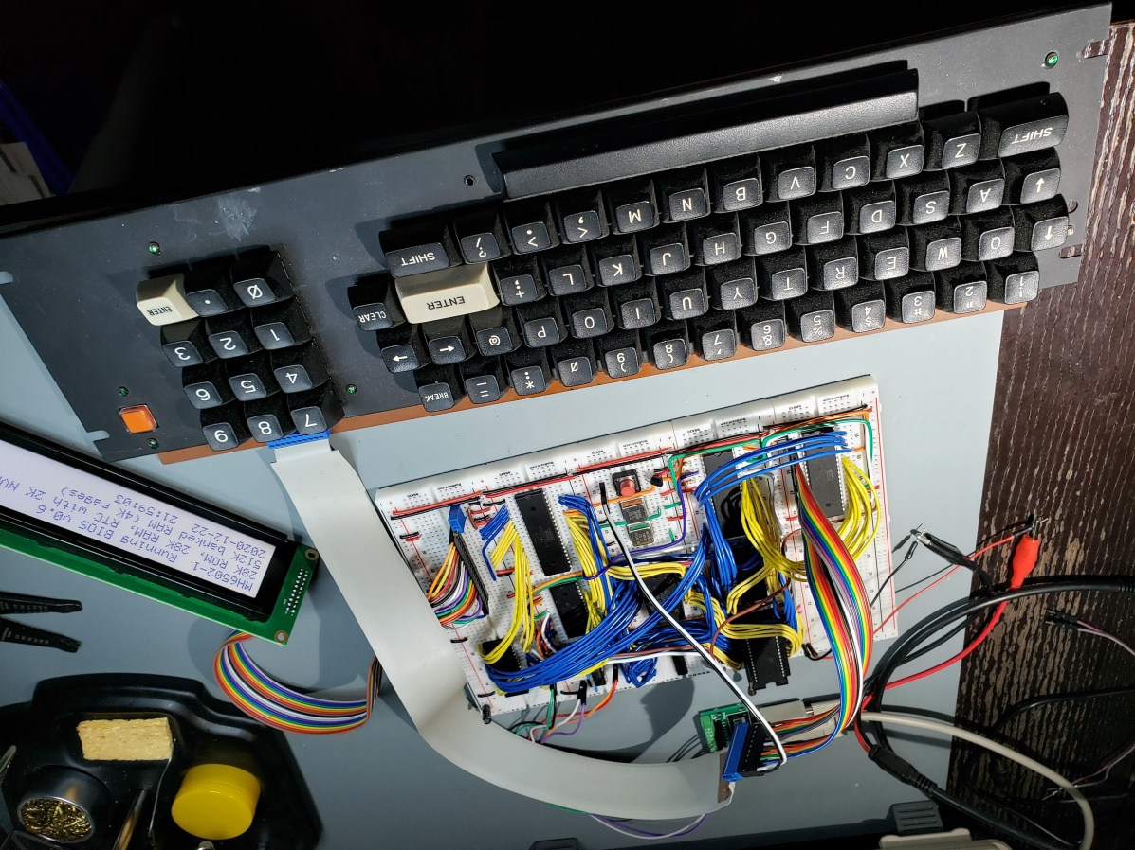
Breadboard history

Slide 7
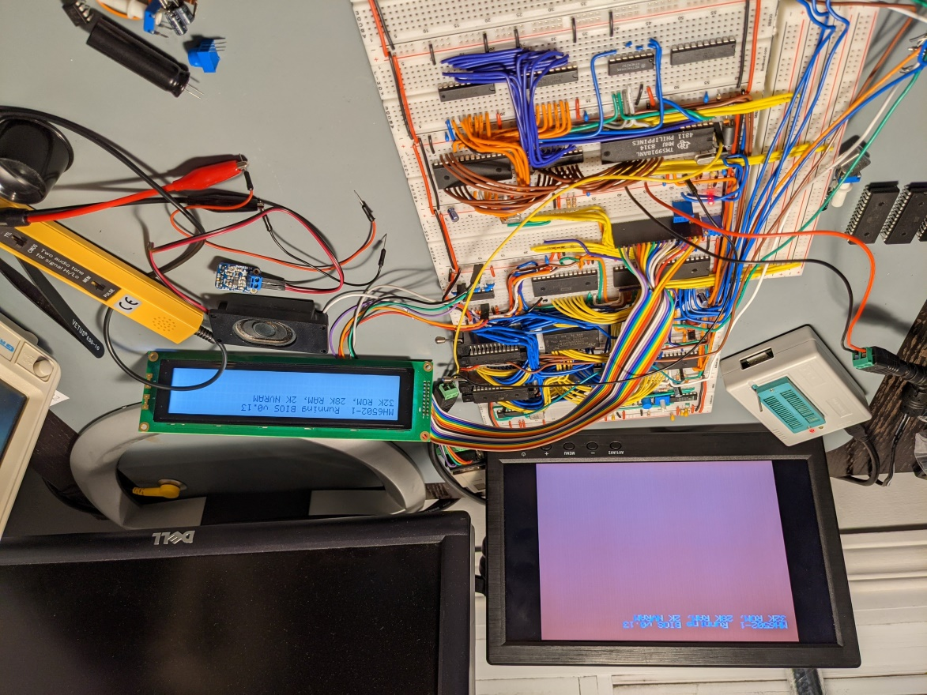
Breadboard history

Slide 8
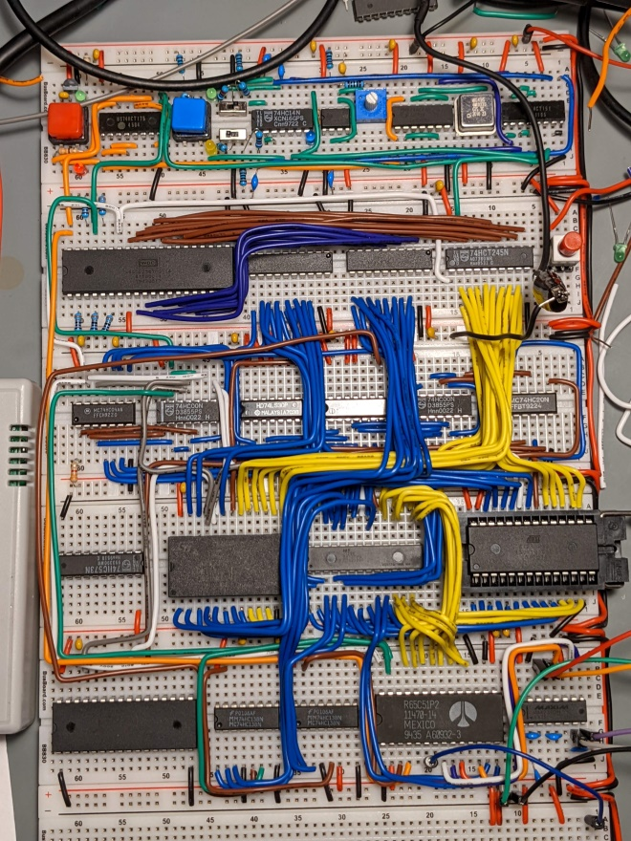
Breadboard history

Slide 9
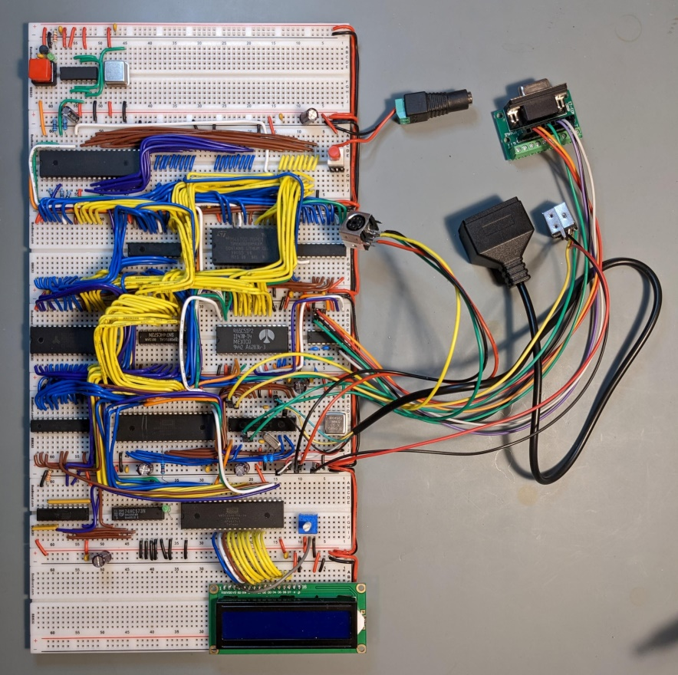
Breadboard history

Slide 10
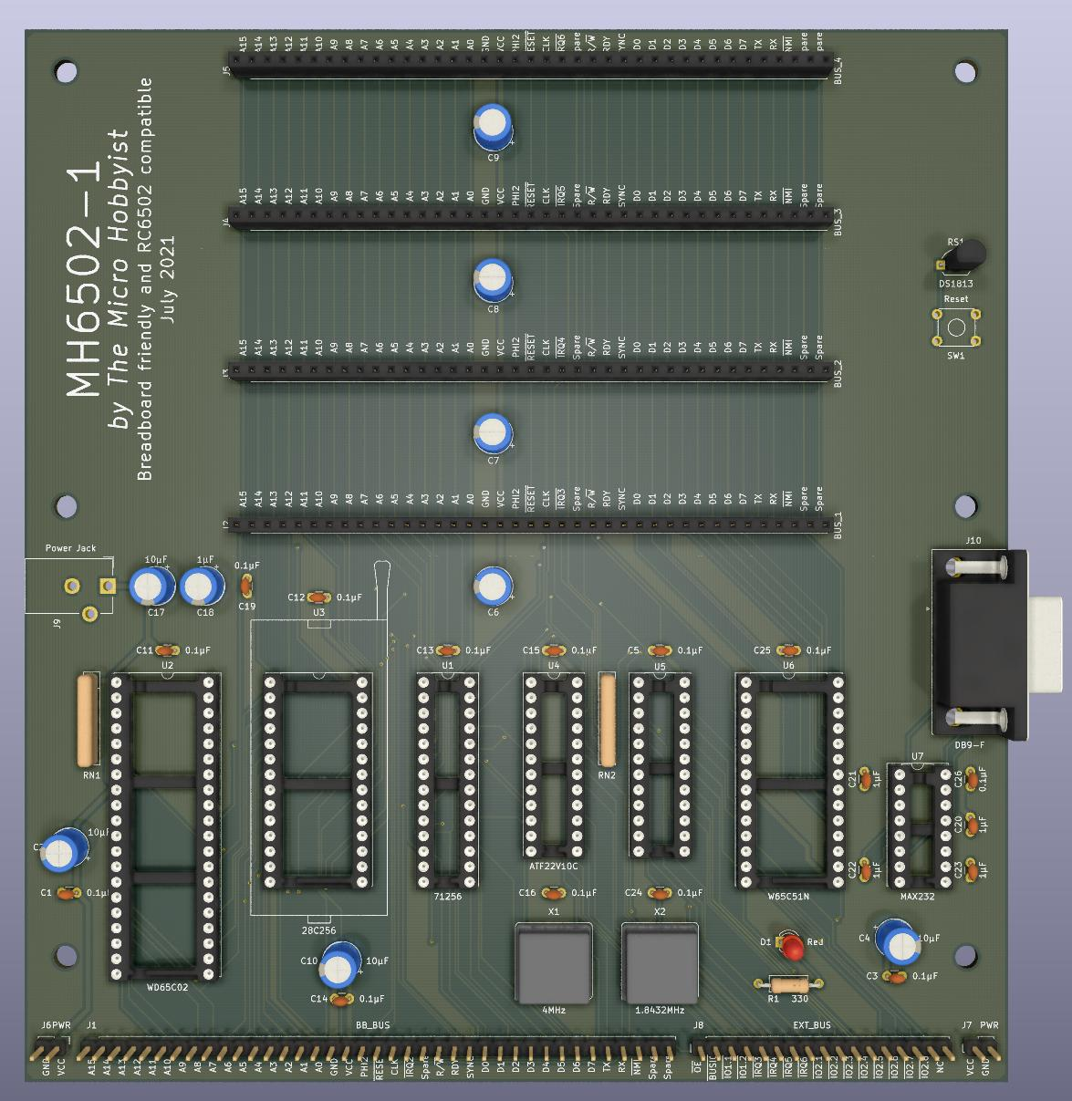
PCB history – Rev 1

Slide 11
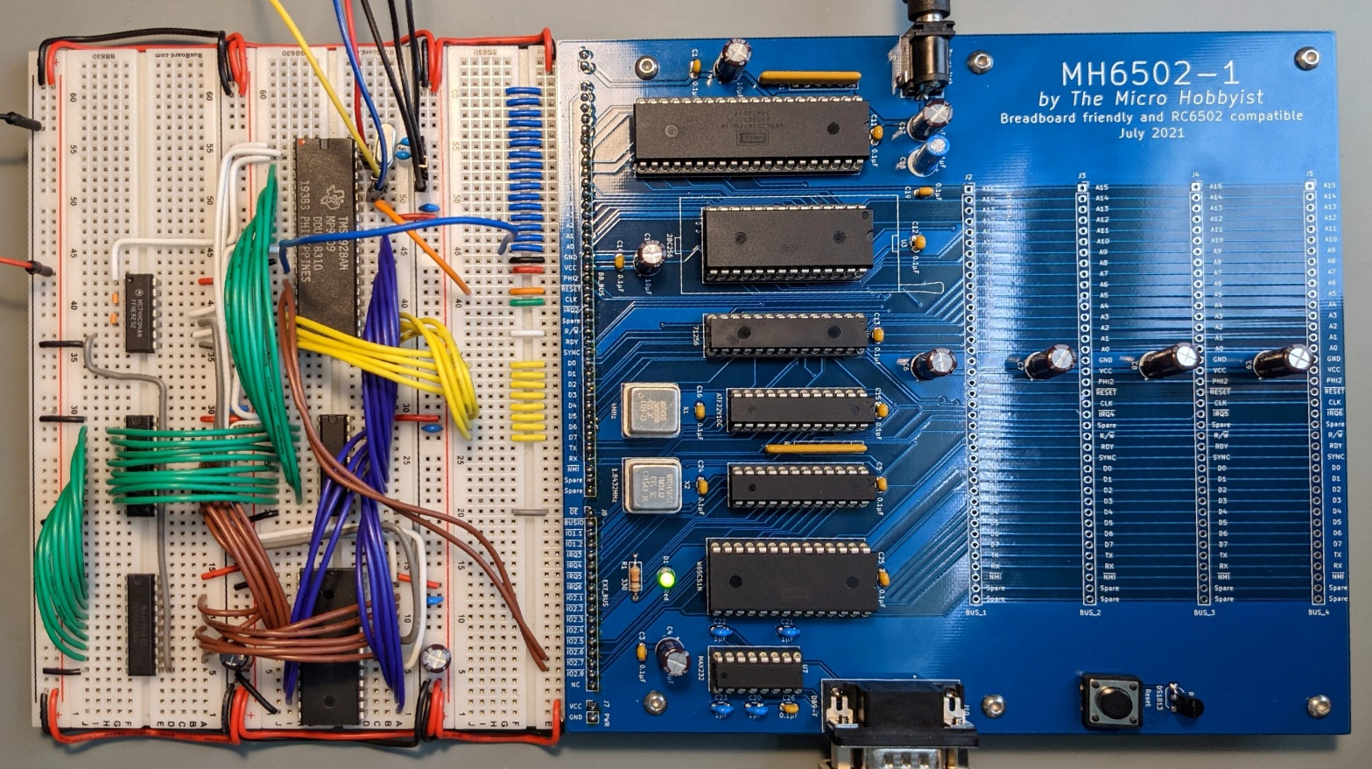
PCB history – Rev 1

Slide 12
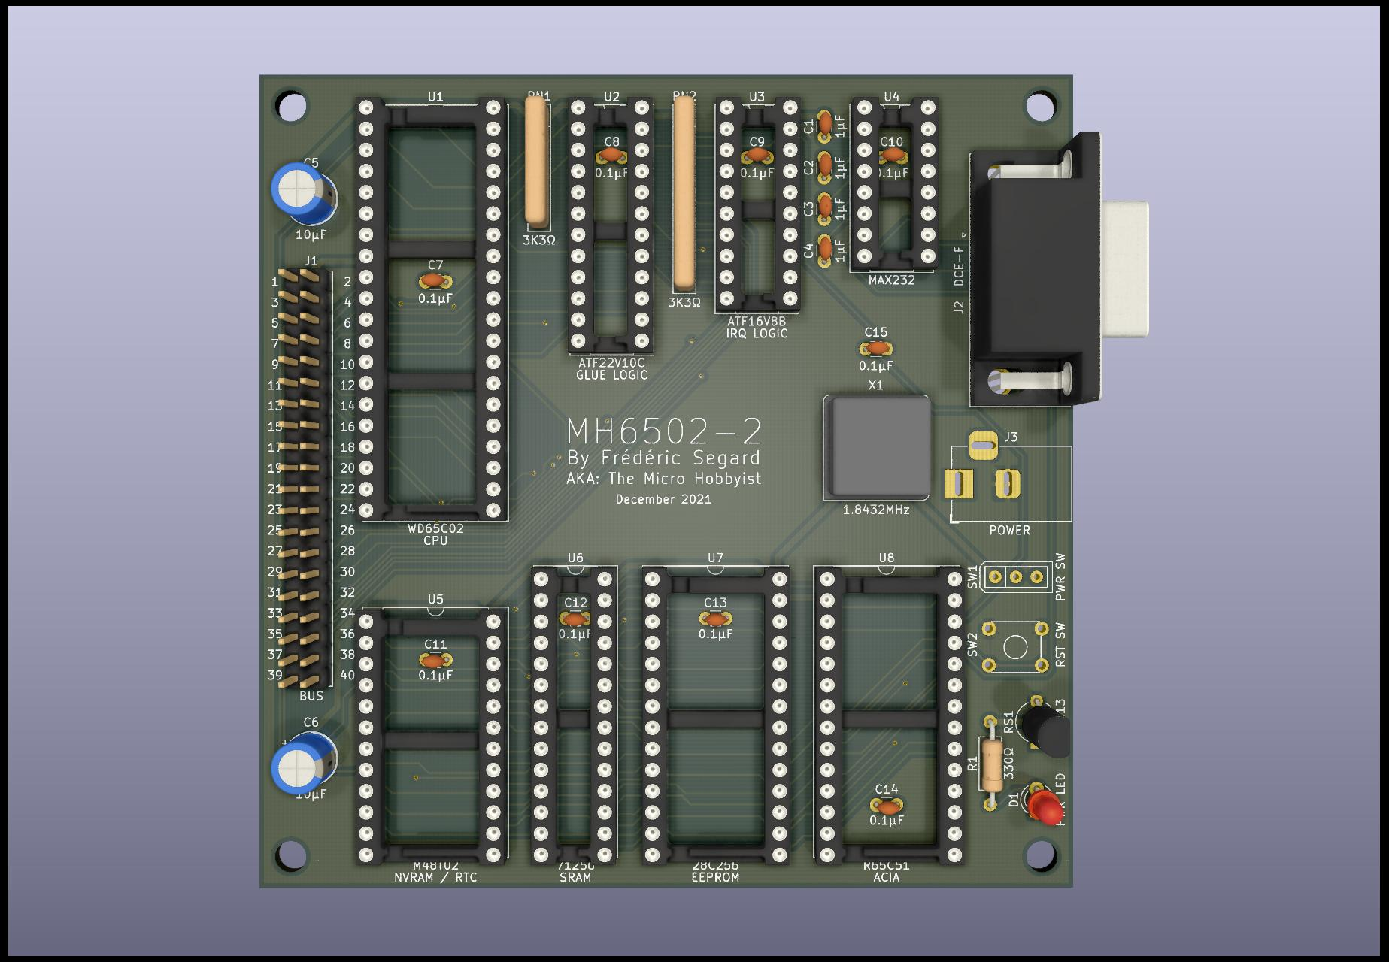
PCB history – Rev 2

Slide 13
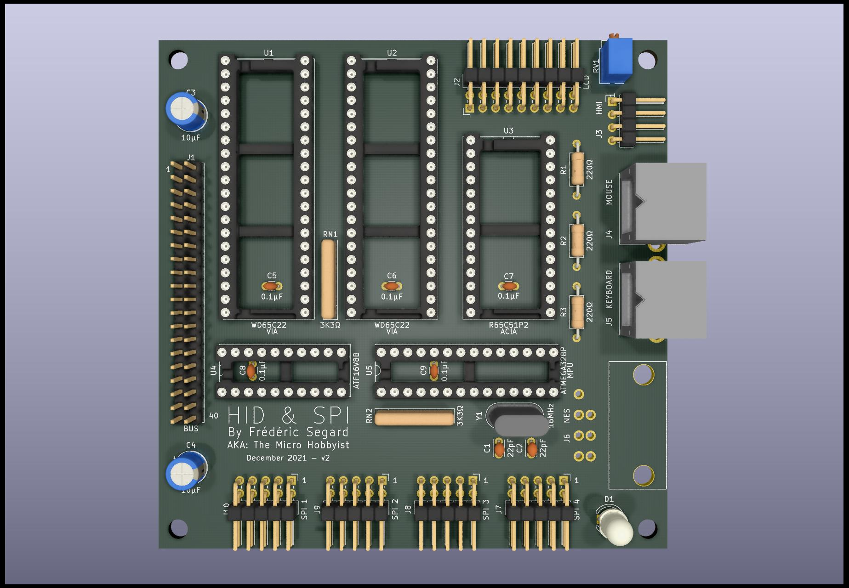
PCB history – Rev 2

Slide 14
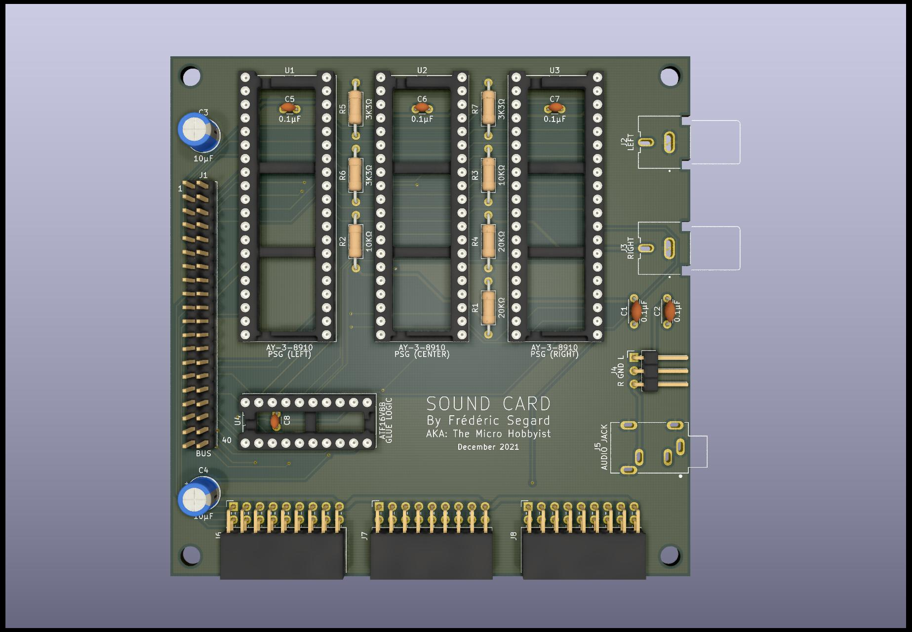
PCB history – Rev 2

Slide 15
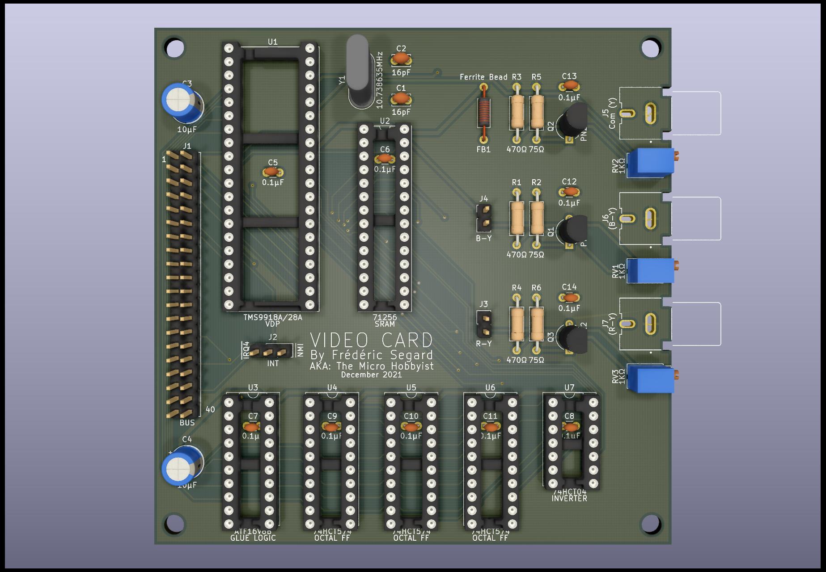
PCB history – Rev 2

Slide 16
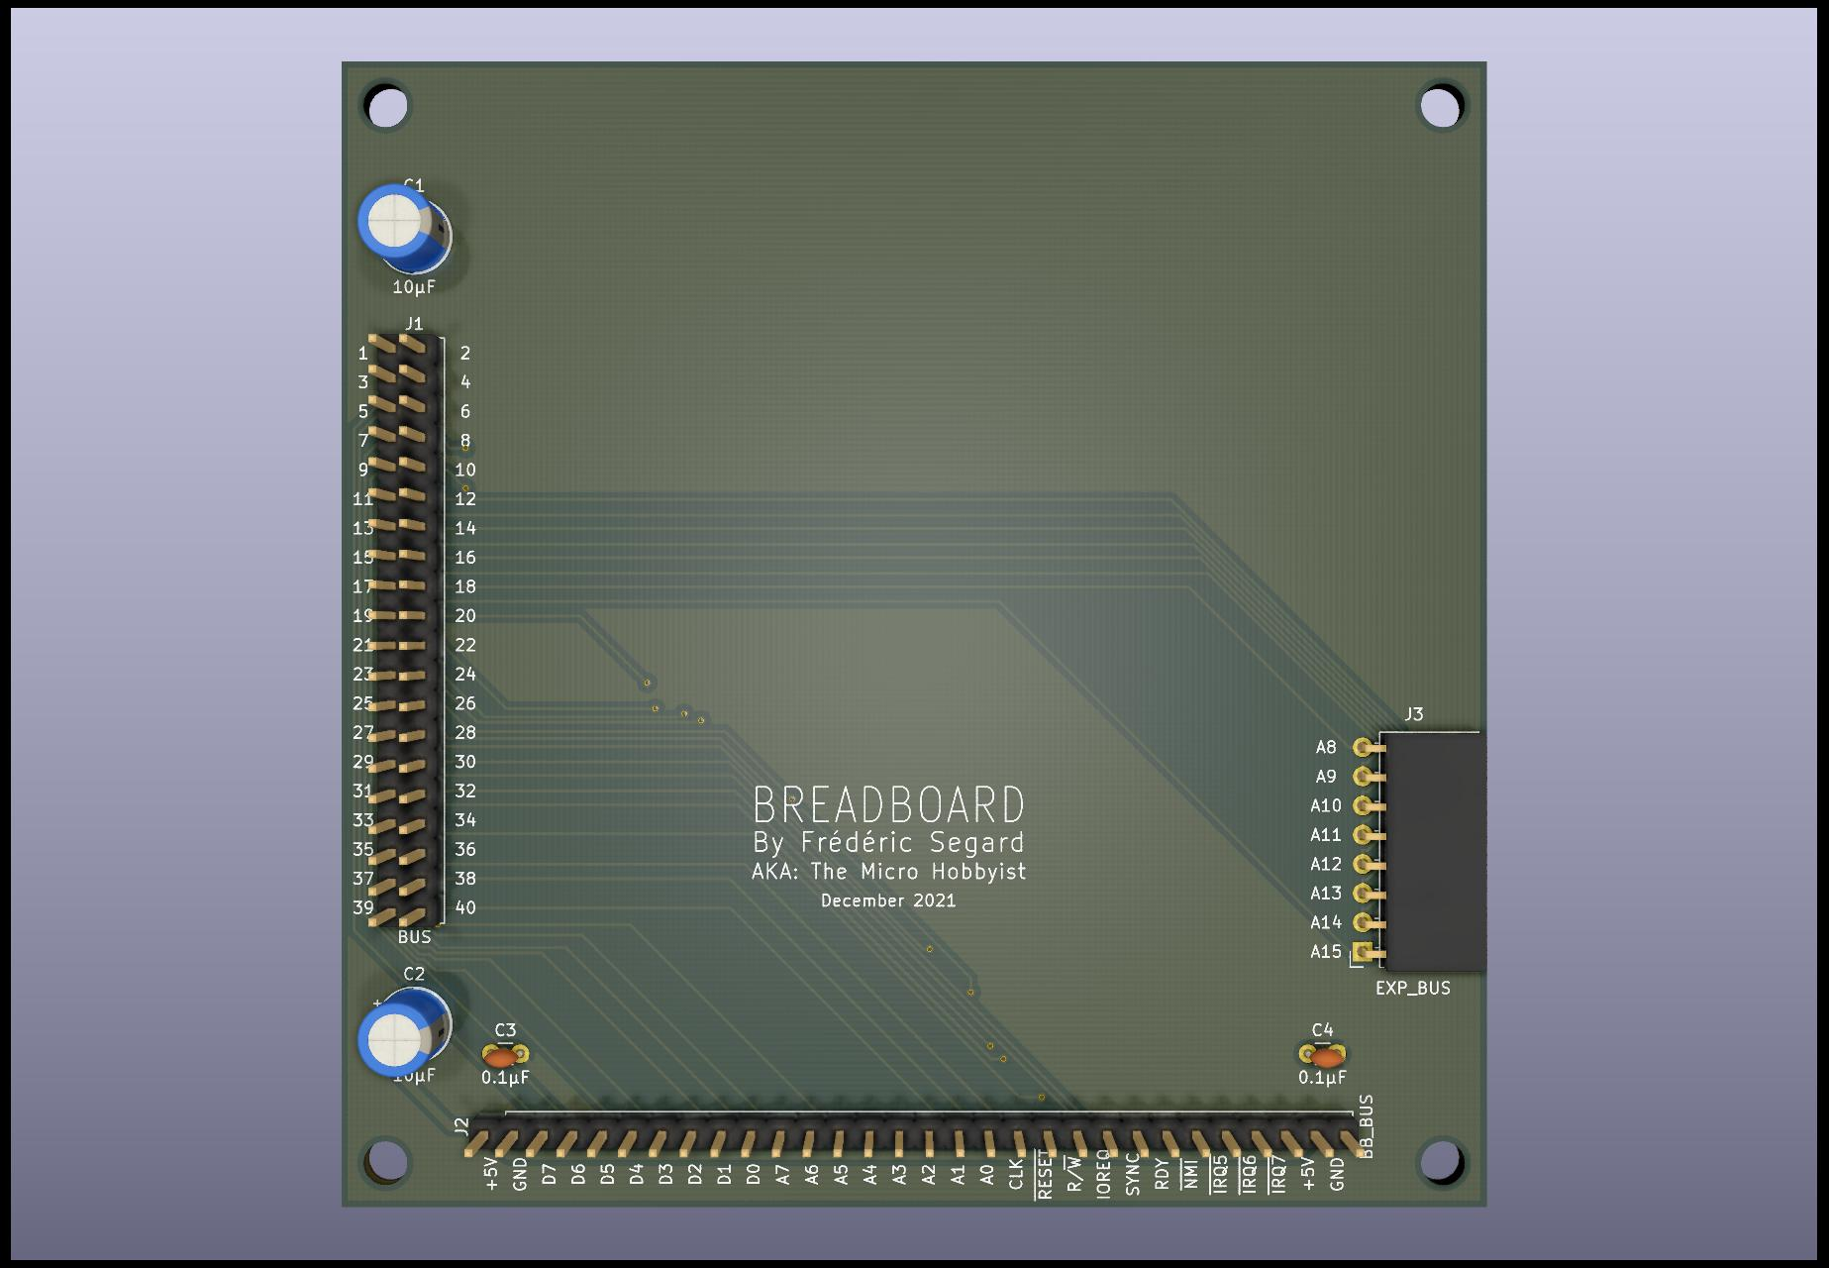
PCB history – Rev 2

Slide 17
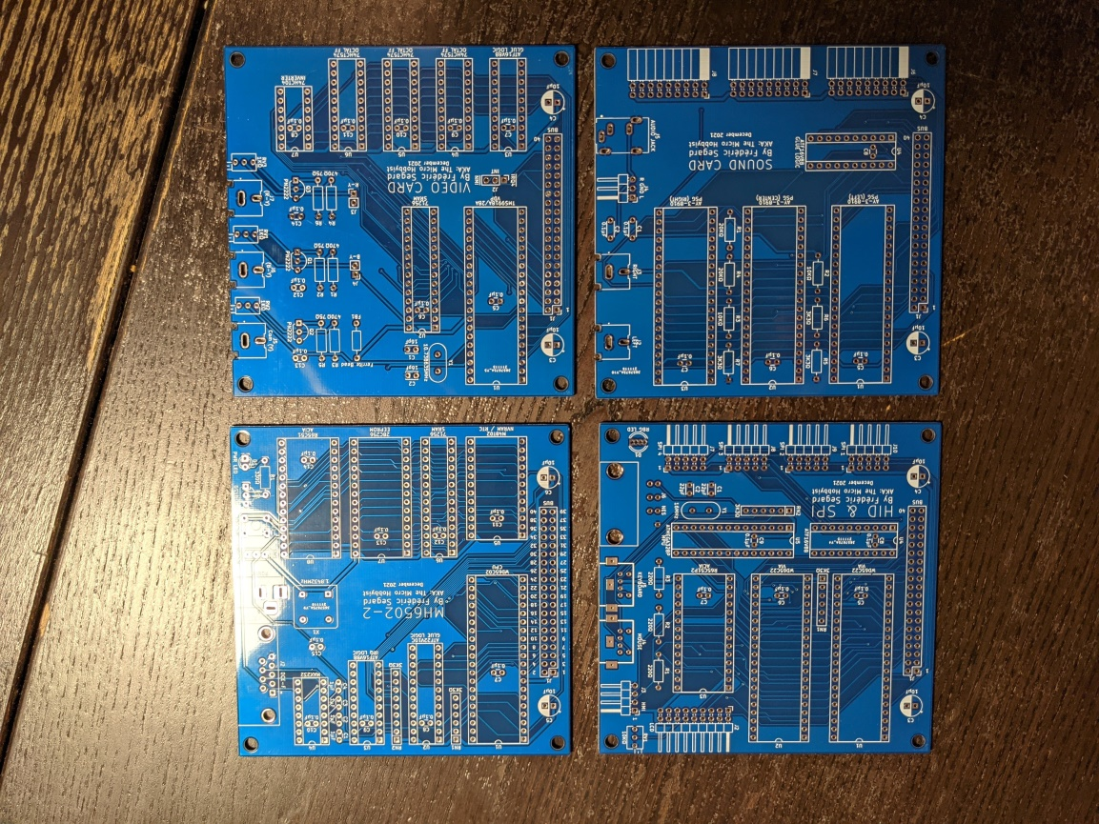
PCB history – Rev 2

Slide 18
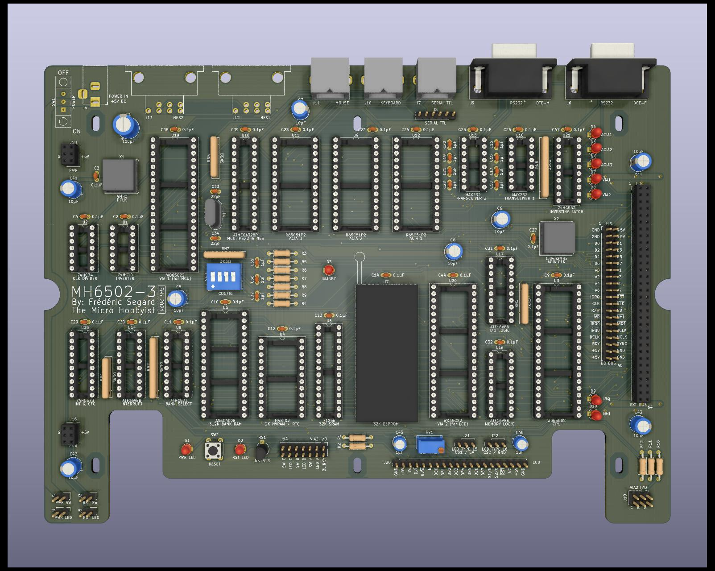
PCB history – Rev 3

Slide 19
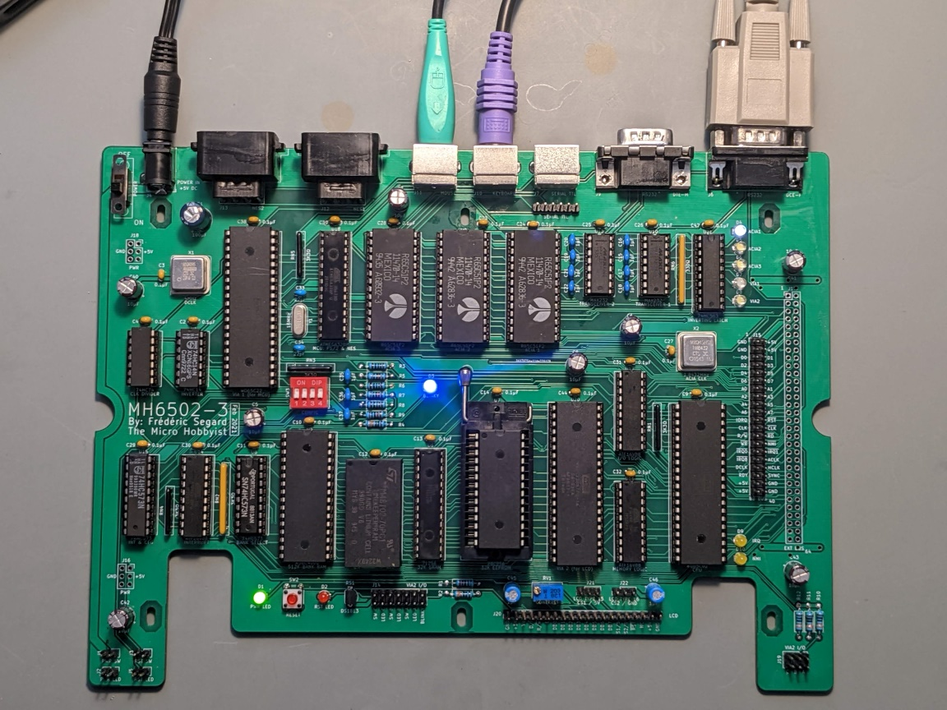
PCB history – Rev 3

Slide 20
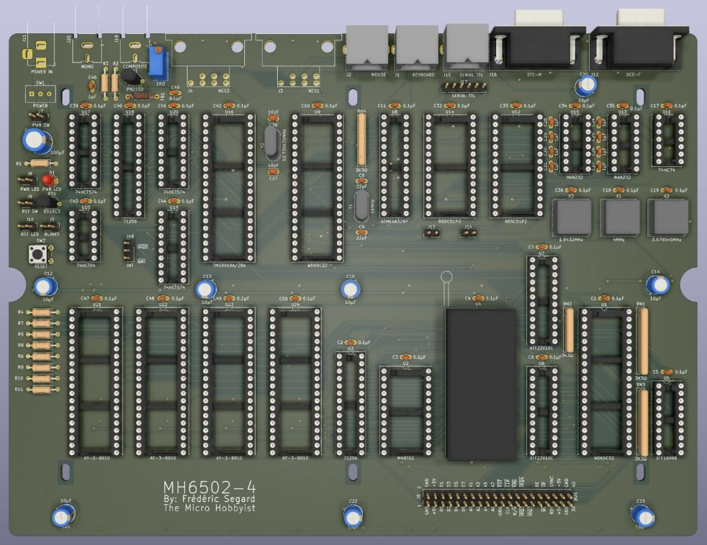
PCB history – Rev 4

Slide 21
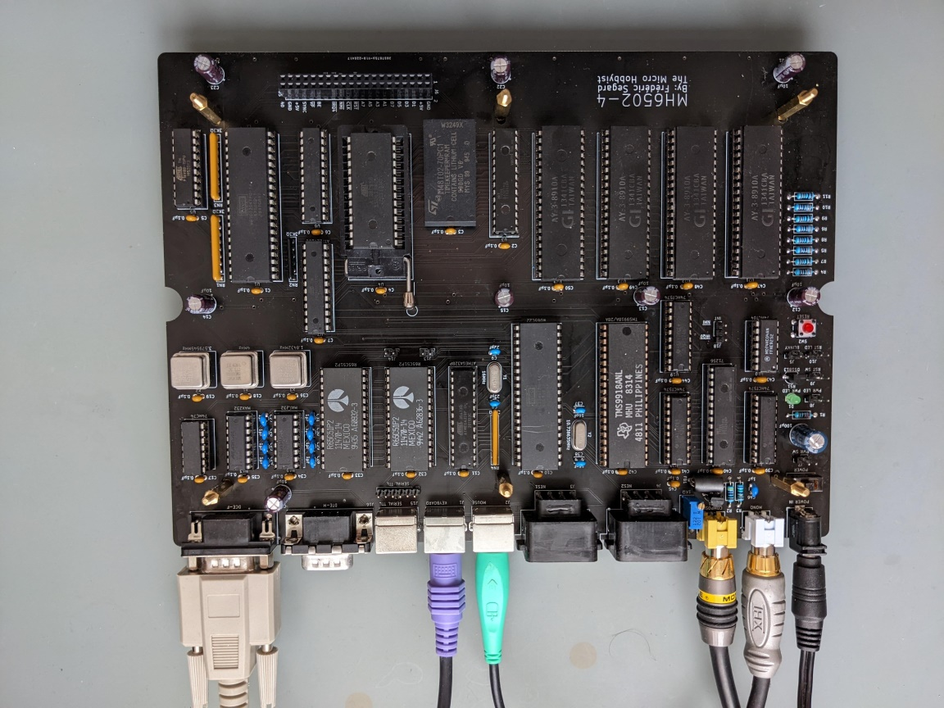
PCB history – Rev 4

Slide 22
Revision 4 specs
W65C02 CPU at 3MHz
ATF22V10 EEPLD glue logic
ATF16V8 EEPLD priority interrupt controller
Memory: 30K RAM, 2K NVRAM, 32K ROM
Dual R6502P2 ACIA (DTE and DCE)
W65C22 & AT328P MCU for PS/2 keyboard, mouse & dual NES controlle ports
Video: TMS9918A VDP
Audio: quad AY-3-8910 PSG

Slide 23
Revision 5 future update
Additionally to Rev 4:
Will at 10MHz+
Either 65C02 or 65C816
512KB extended RAM
Additional PSGs? (for a killer music box)
TMS9928A VDP (component) or VGA circuit
SD Card reader or CF card reader
More TBS

